Slide 1
HOW HPC INCREASED THE COMPETITION IN F1
Mirac Aydin
mirac.aydin@gwdg.de
10.05.2023

Slide 2
CONTENT
HPC Applications
HPC Usage in F1
Success Stories

Slide 3
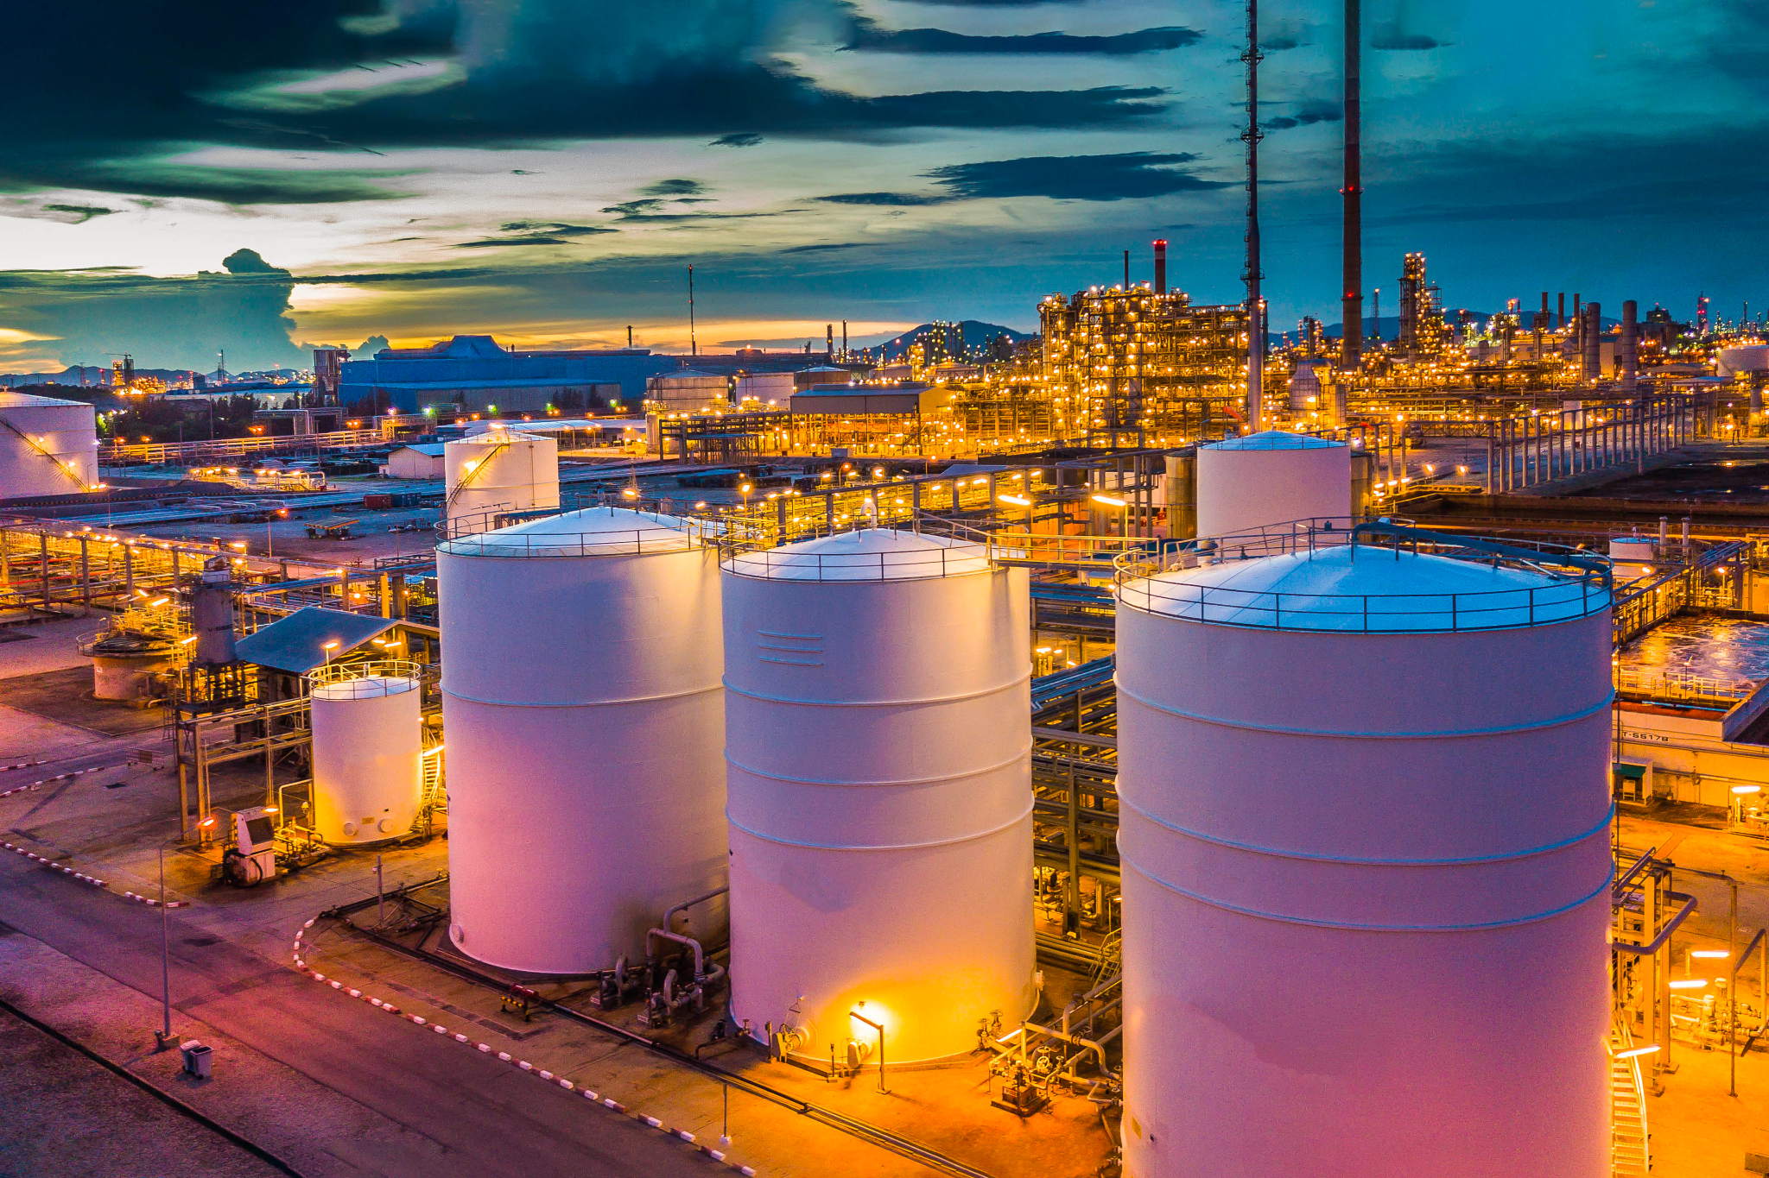
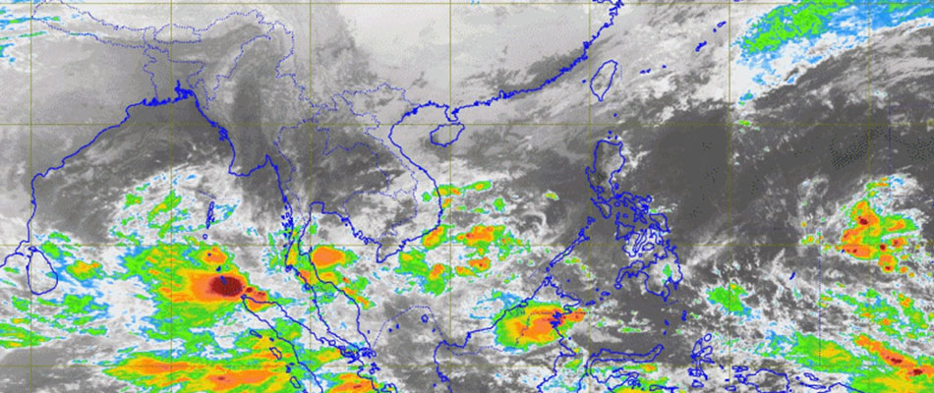
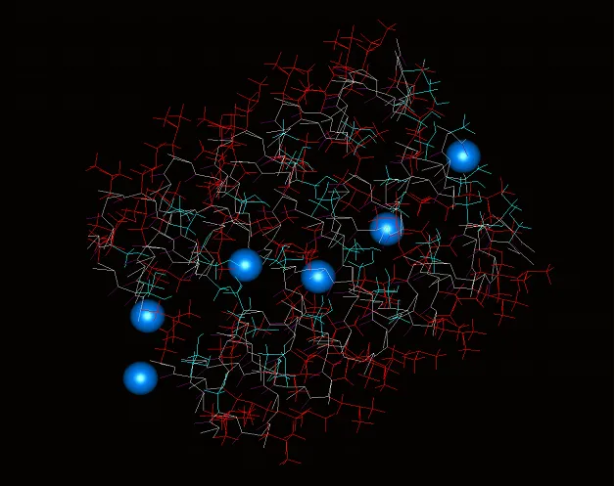
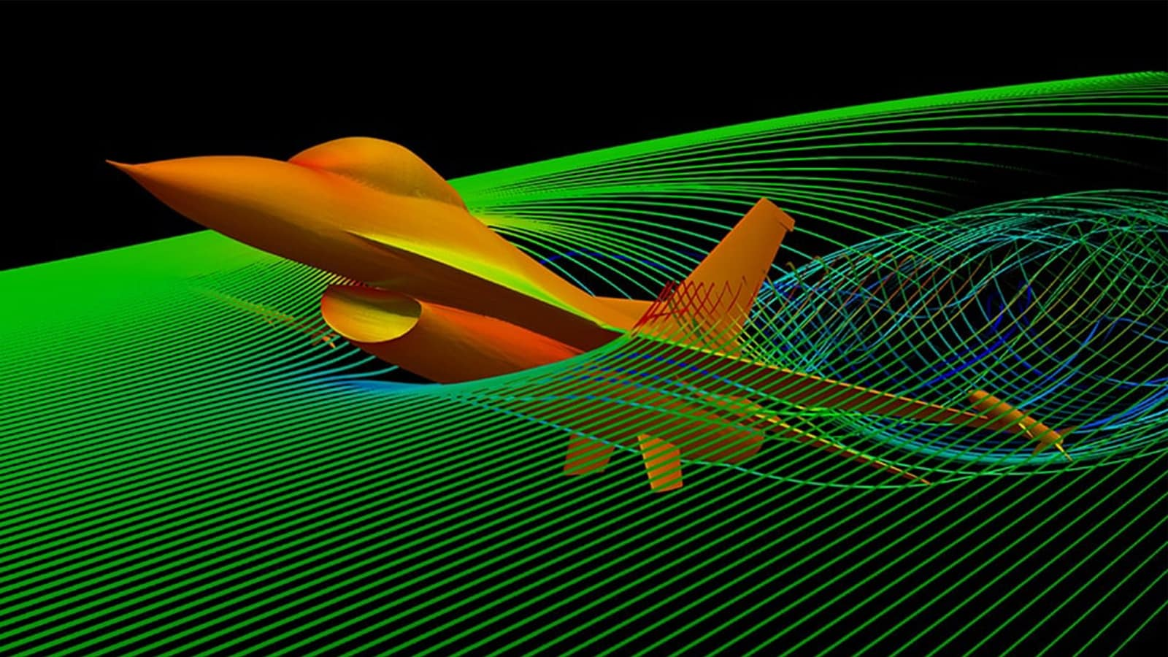
HPC APPLICATIONS
Almost everywhere…
Machine Learning &
Deep Learning
Finance
Oil & Gas
Genomics
Weather & Climate
Molecular Dynamics
Aviation & Automotive

Slide 4
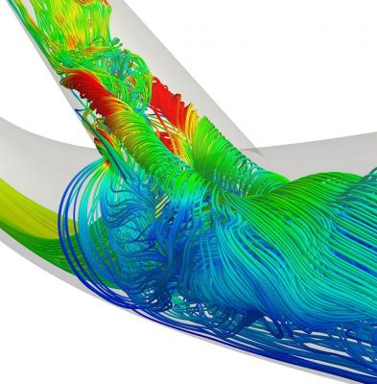
WHAT IS FLUID DYNAMICS?
We are surrounded by fluids
Blood flow in human body
Wind flow around objects such as cars, planes etc.
Investigation of movement of liquids and gases
Blood flow
Air flow

Slide 5
WHAT IS FLUID DYNAMICS?
Experimental studies are performed with laboratory-scale protoypes
PROS | CONS
Exact scenario in real world | Extremely expensive
Easy to understand | Fixed setup
Direct measurement | Requires wide range of tools

Slide 6
WHAT IS FLUID DYNAMICS?
The most popular experimental setup is wind tunnel

Slide 7
COMPUTATIONAL FLUID DYNAMICS
Fluid dynamic simulations
Thanks to Moore’s Law for powerful CPUs
Popular tools:
Ansys Fluent
StarCCM
OpenFOAM
PROS | CONS
No physical setup and rapid design | Needs compute resouces
Much cheaper | Limited to the model
Gathers lots of data | Not easy to understand

Slide 8
COMPUTATIONAL FLUID DYNAMICS
Rear wings drug reduction system (DRS) simulation with CFD
Helps engineers save a lot of time by making certain calculations

Slide 9
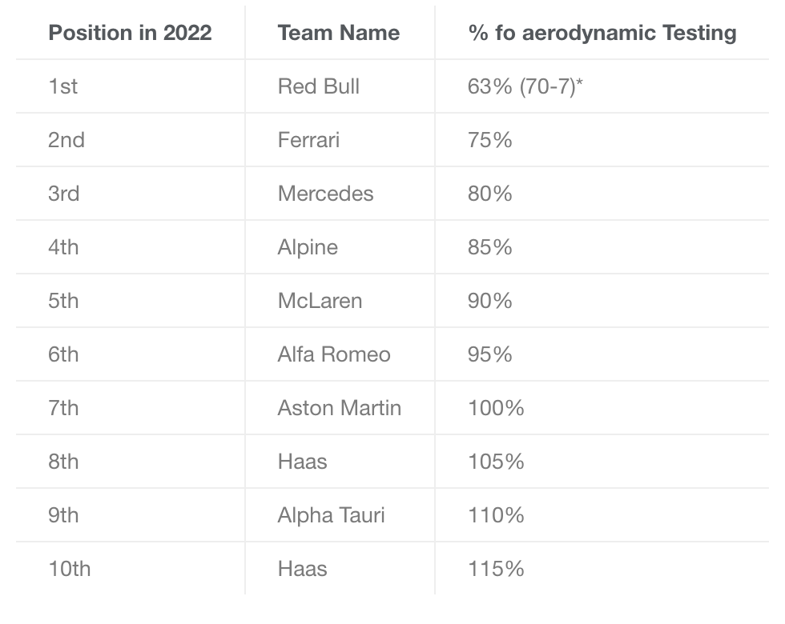
COMPUTATIONAL FLUID DYNAMICS
FIA brought in certain rules and regulations, including limitations on CFD and Wind Tunnels.
According to the 2022 rules and regulations, the team that finishes last will receive the maximum amount of CFD and Wind Tunnel time, while the team finishing 1st will receive the minimum.
The percentage of aerodynamic testing each team compared to the rest for the 2023 season.

Slide 10
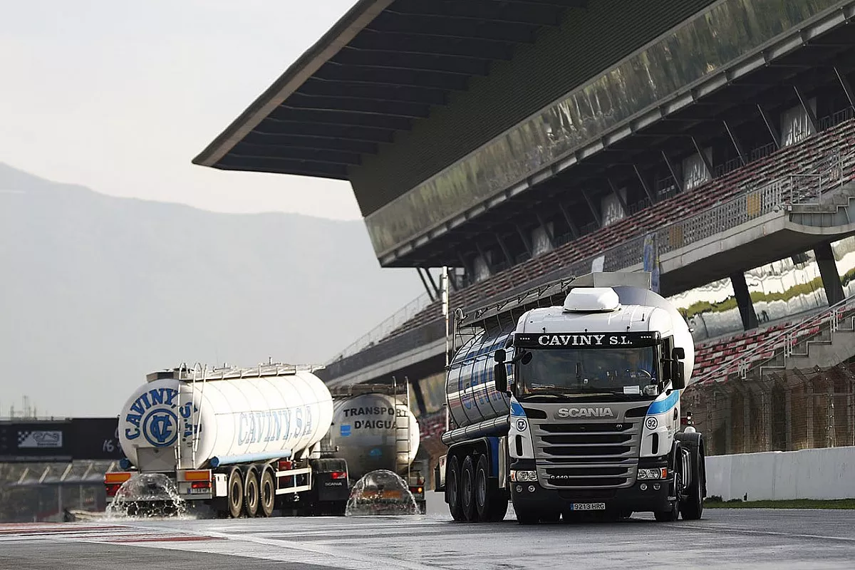
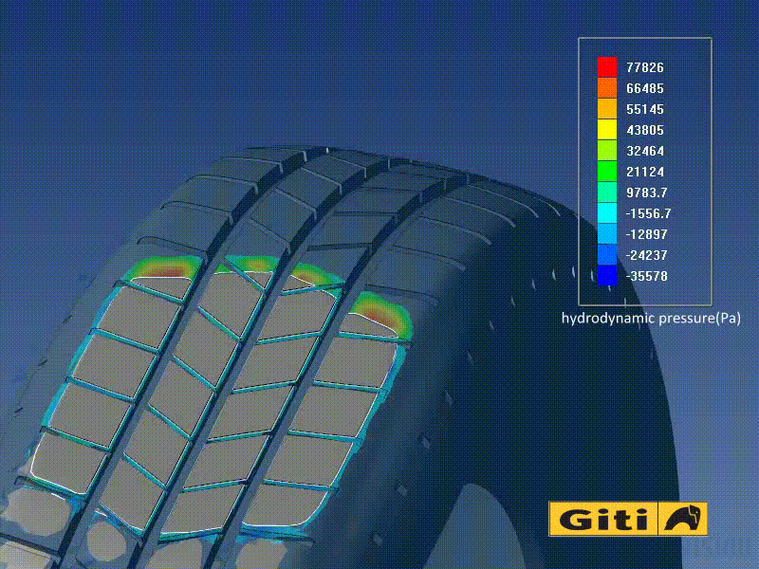
COMPUTATIONAL FLUID DYNAMICS
Tyre testing by tyre companies
Example scenario:
Wet tyre testing in summer seasons
Monaco GP
Weather is 35C
Water sprinkler systems
You can speed up the testing processes with CFD

Slide 11
INVESTMENT OF TEAMS
Some examples of HPC investments of F1 teams
Formula1 → AWS Cloud (Cutting CFD costs by 30%)
Mercedes-AMG Petronas → HPE
McLaren → Dell Technologies
RedBull → Oracle Cloud
Ferrari → AWS Cloud

Slide 12
SUCCESS STORIES
RedBull Team:
Started to use HPC on IBM Platform Computing around 2007
Developed their cars with mainly CFD simulations rather than wind tunnels
Won 3 consecutive championships from 2010 to 2012 with Sebastian Vettel.
Marussia Team:
They started racing in 2010, not enough budget (30£) to rent wind tunnels
They invest their money on HPC in 2012
First championship points in 2014
After the 2015 season → Manor Racing

Slide 13
RESULT
The competition increases the quality of races
1
Technology increases the competition between teams
2
CFD is a very cost effective technology
3

Slide 14
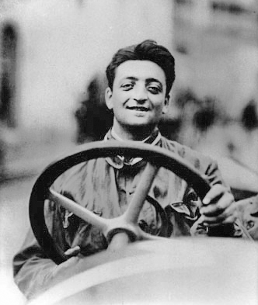
“Aerodynamics are for people who can’t build engines”
Enzo Ferrari

